Slide 1
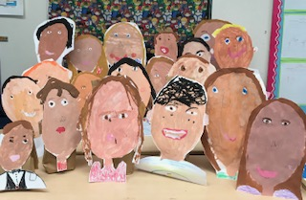
First Grade Open House
1D

Slide 2
Drop Off and Pick Up
Please make sure your child arrives at school on time (8:00 am)
If your child is late, please see Ms. Costello (at the other end of the hallway) or go to the main office to get a late pass.
If your child is early, he/she may go to the cafeteria at 7:30-7:55. At 7:55 teachers/vice principals will dismiss students to their classes.
You may pick up your child outside of the classroom.
If you need to pick up your son/daughter early, please check into the main office so they can enter it in the computer.

Slide 3
Lunch and Snack
We have snack every day. Please make sure you pack a peanut free snack.
If your child is having trouble learning his/her lunch number, let me know so we can practice at school as well as at home.
Please pay your bill online or go to the cafeteria and put a check in an envelope.
Children will not be allowed to use money. If there is a problem with the account, we will serve lunch to your child and bill your account.
Notes:
Not to share food this year If you need to drop something off, please leave it at the office at “the drop off” spot

Slide 4
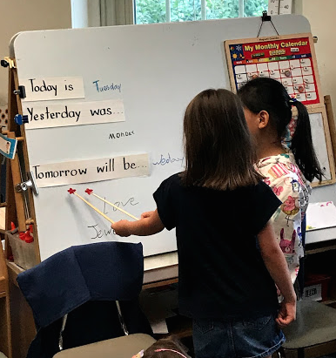
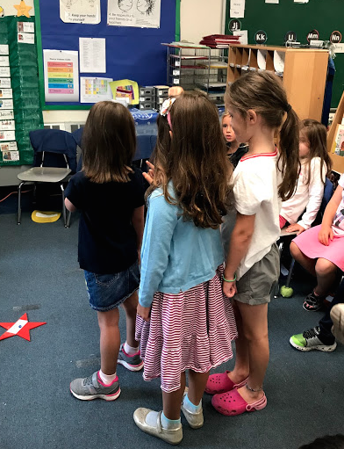
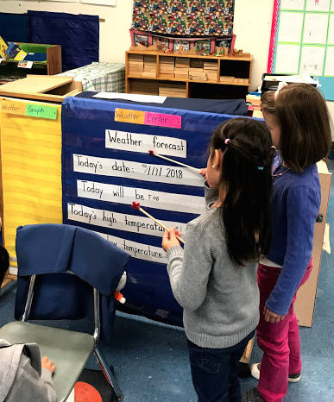
Morning Meeting
The components of Morning Meeting provide daily opportunities to develop academic and social skills.
Our morning routine is based on kindergarten routines, but the children are taking more responsibility by running the whole group meeting.
Notes:
Our day begins asking children to read and follow the directions in the letter
Then it moves on by giving children the responsibility of writing the message, changing the calendar, looking at the weather, counting the school days
This is gradually done more independently and children are practicing speaking, presenting and writing in front of a group.

Slide 5
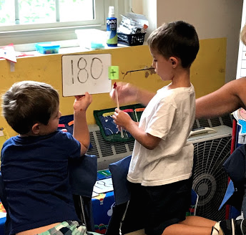
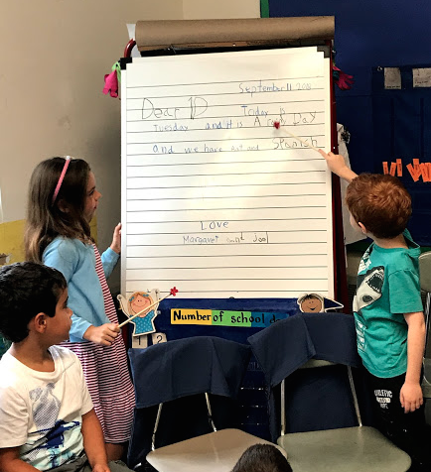
Morning Meeting
Academic goals:
develop writing skills
communication skills
develop ideas through descriptive language
number sense
understand and present information from the calendar
weather predictions
Social goals:
develop empathy
develop listening skills
practice being polite

Slide 6
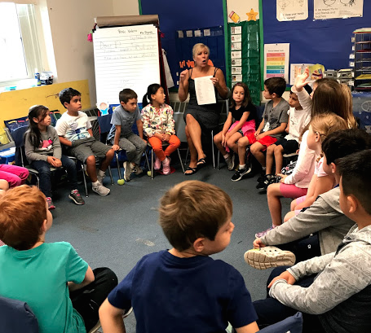
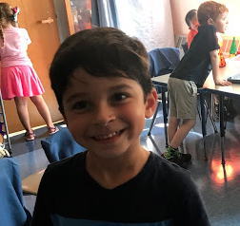
What happened to Show and Tell?
A daily share shifts the focus from kindergarten “Show and Tell” to describing meaningful experiences or anticipating exciting events. Sharing these experiences helps children develop effective communication skills by using descriptive language rather than using a concrete object.

Slide 7
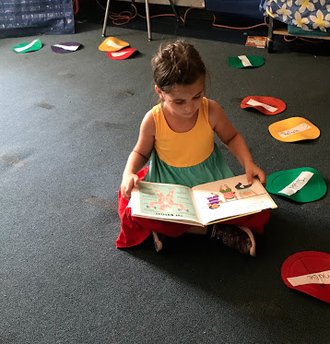
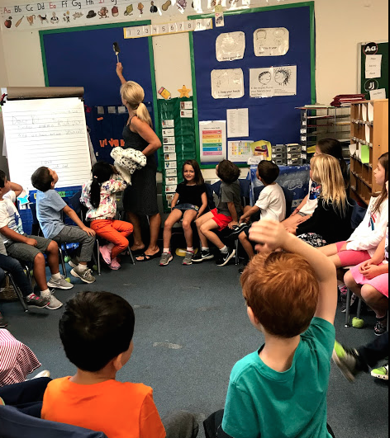
Reading
Whole group shared reading
Read alouds
Quiet reading/Independent reading
Direct teacher instruction in whole group provides a model for the class
Small group instruction (reading workshop)
Morning Reading: Tuesdays and Thursdays throughout the school year from October – early June in the pit.
Notes:
Encourage children to bring in a book of interest to read during transition times for independent reading

Slide 8
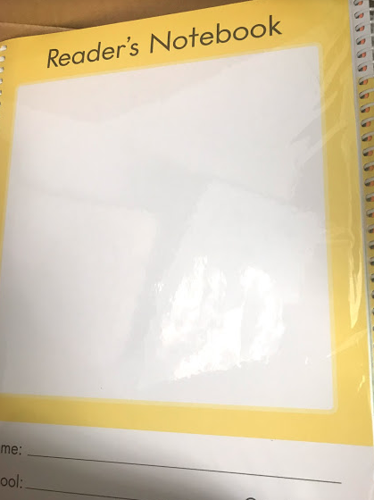
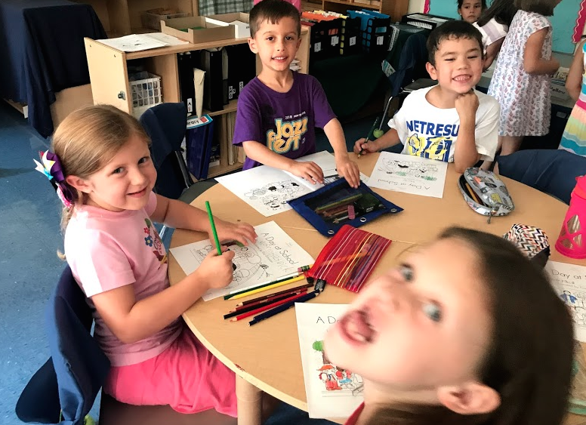
Reading Workshop
Teacher creates group reading instruction based on information collected with the BAS (Benchmark Assessment System)
Small independent groups engage in word play with word work
Pairs read around the room
Small groups read and respond to books in their reading journals
Partner reading
Independent quiet reading
Fundations Phonics Program

Slide 9
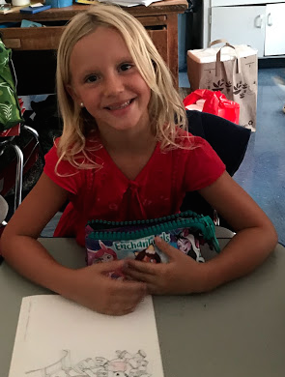
Writing Workshop
HWT: Handwriting without tears program helps children develop lower-case letter formation in first grade.
Lucy Calkins writing program encourages children to write books based on experiences. In first grade the focus begins to shift from putting our ideas on paper to developing the story with the reader in mind.
Whole group writing includes the morning message, class letters, classroom signs/messages.
Creative writing
Personal Narratives
Persuasive Writing
Non-fiction
Poetry
Notes:
“Write for readers” Is my writing neat enough so another person can read it? Is my spelling easy for another person to read? Tapping out words. Does the story make sense for the reader?
Non-fiction writing in science and social studies

Slide 10
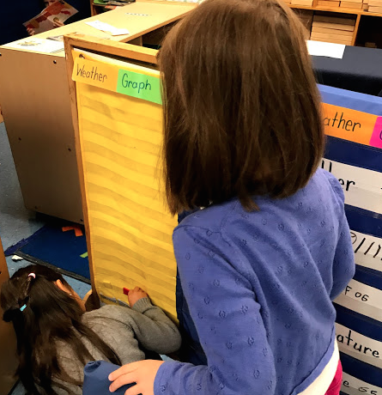
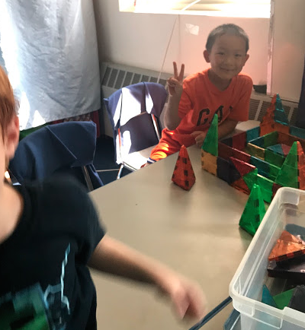
Math
Whole group math instruction gives us an opportunity to introduce new concepts, talk about different ideas and explore various solutions.
Kathy Richardson’s math program uses a small group, center based approach that encourages flexible learning
Math notebooks cover a wide variety of open ended math topics that help children talk about math ideas.
Authentic math experiences throughout the day. We practice math daily (calendar, school day counter, story problems, temperature recording and time associated with our schedule).
Morning Math: Mondays and Wednesdays throughout the school year from early October– early June in the pit.
Notes:
Kathy Richardson provides a solid mathematic foundation of counting and number understanding
math notebook encourages conversation and exploration of math ideas with various ways to reach an answer and explain thinking.

Slide 11
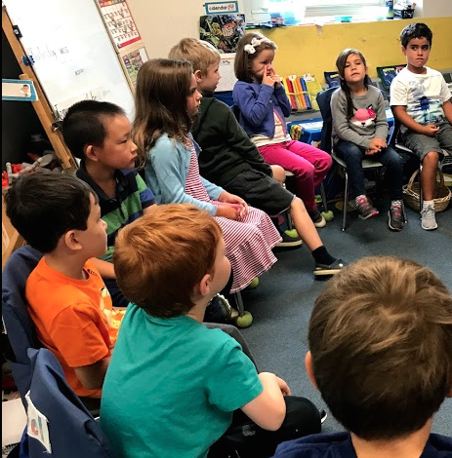
Math Choice Time
Kathy Richardson’s Math Concept Assessments and link these assessments to hands-on small group direct teacher instruction that target a specific goal.
The small group work is done in flexible grouping format because it is based on a common objective.
Children explore mathematical concepts using a variety of materials.
Notes:
Similar to reading workshop

Slide 12
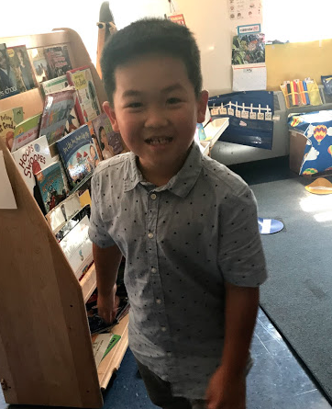
First Grade Math Concepts
2 and 3 dimensional figures and patterns
Number lines
Time
Skip counting
Money
Addition
Subtraction
Working with groups of tens
Data and probability
Working with larger numbers
Doubling and halving
Fractions (hands-on coupled with writing it in a math way)
Maps and grids
Combine numbers
Temperature
Weights
Length area and capacity
Making and breaking numbers
Exploring rules and number patterns

Slide 13
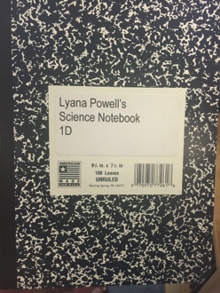
Science
Time to explore, observe, wonder, and communicate.
Investigate living things in our environment.
Focus is on communication and collaboration. Science Talk encourages children to talk and explore ideas with each other.
We emphasize on observations over time---drawing and writing in our science notebooks. Our science notebooks are one of the most important tools we have to tell the story of our science investigation over the school year.
Notes:
Our

Slide 14
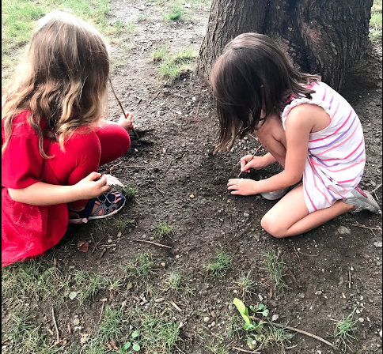
First Grade Science Units of Study
Nature
Light and shadows
Sound
Insects
Science is often weaved into literacy and math daily, but a few times a week we have dedicated times to explore science as a whole group.
A variety of classroom pets for exploration

Slide 15
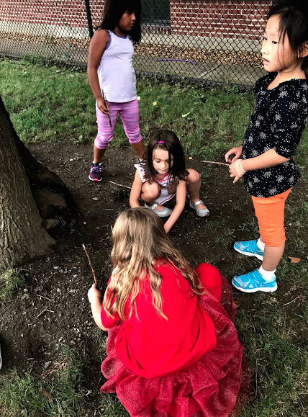
First Grade Field Trips
Moose Hill
Wheelock Family Theater
Science Museum
Boston Public Library

Slide 16
Social Studies
We begin the year by studying classroom/school rules and then branch out to our community and country.
Continue to explore the variety of cultures and traditions of families here in our classroom and beyond. Families are welcome to come in and share various cultural traditions.
Historical thinking: national symbols, holidays, leaders, and monuments.
We explore our world by using maps, globes, and atlases.
Compare and contrast America with other countries. We explore China and Mexico.
We extend our study of economics to begin to look at other places around the world.

Slide 17
Classroom Management: Problem Solvers
Explicit teaching of the rules
Examples of rule following behaviors shown by students in 1D
Talking about how we feel
Peace Flower as a tool to help children talk about their feelings. The Peace Flower Log serves as a way to document problems/solutions to help us solve the problems in the future.
If a problem persists or spreads, a group discussion with class solutions are developed to solve the larger problem.
Notes:
Examine problems in two ways: naming the problem and ways to prevent it from happening again and talking about how we feel when problems arise with friends.

Slide 18
Classroom Management: Challenging Behaviors
Positive reinforcement and models are the preferred method for keeping the classroom running smoothly
If there is a problem, a warning is given
If the problem continues, then a five minute break from a preferred activity is implemented
If the child works hard to correct his/her behavior, then the time is earned back in one minute increments.
If the child is not on a model spot by the end of the day, then he/she will not get a sticker that day.

Slide 19
Behavior Management: Academic Accountability
Each child will have a contract with Reading Workshop on one side and Math Choice on the other.
This functions as a weekly “To Do” list
Your child may choose anything on the list during literacy and math.
When he/she completes the task, then she/he may stamp the circle.
The children will all work towards the goal of finishing all the activities by Friday.
The contract should come home on Friday with a large happy face on it.
If a child does not finish, he/she will complete it instead of free choice
Notes:
The idea behind this system is to give the children structure, but they have the freedom to choose their daily activities. This system also gives them a chance to explore time management.

Slide 20
Positive Behavior Intervention Support
PBIS is a prevention-oriented way for school personnel to develop proactive strategies that define and teach expected student behaviors in a positive school environment. This is coupled with expected consequences, data-based decision making, and reinforcement.
Penguin Points may be earned by students at Pierce School when they are showing positive behaviors. The Penguin Points are collected so 1D can earn extra recess.
Notes:
Goal is to earn extra recess at the kindergarten playground

Slide 21
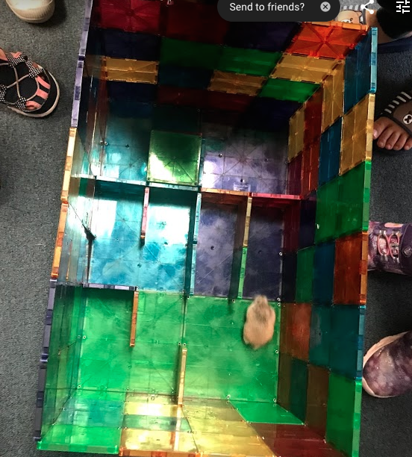
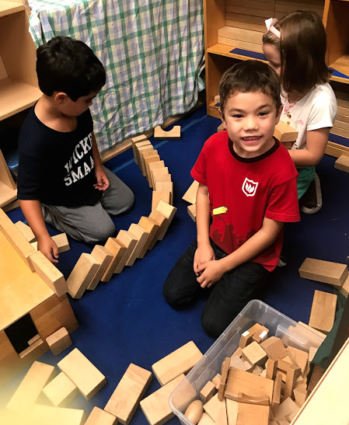
What the children want you to know:
Morning and weekly Jobs
GoNoodle for healthy bodies
Seat Sacks for our books, pencils, and crayons. We leave our pencil cases in our seat sacks.
New line order each week
Hall pass
Crebbit, Bob Cookie, Bob Fluffy, Nancy and Henry are our pets
We sit on chairs on the rug
Quiet reading area
Quiet spots
Activity Time
Making mazes
Movie Friday
Notes:
Activity time is totally free choice

Slide 22
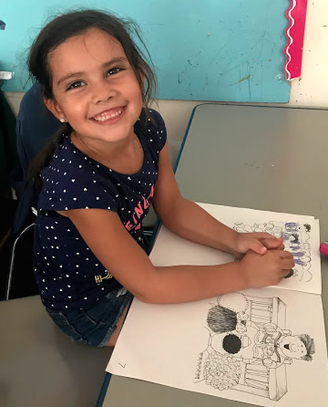
Check us out:
Bring “Take Home Folder” daily: please keep reading logs and communication logs in the folders.
Twitter @MsEDaly
http://pierce1d.weebly.com/
Go on the website and click the link to sign up for the Pierce School Directory
Notes:
Try to check the website once a week. I usually update it on the weekends.

